Slide 1
“We choose to ... do … things, not because they are easy, but because they are hard”
– JFK, Rice University, 1962.

Slide 2
International Baccalaureate
Registration Night
Kenmore East’s New Adventure

Slide 3
Agenda
Patrick Heyden | Welcome
Dave Coates | IB and college
Paul Lasch | The IB core
Chris Knab | TOK presentation
Denise Carr | CAS notes
Will Crosby | Perspective from an IB Senior
Jenna Papaj | Another perspective from an IB Senior
Paul Lasch | Registration Materials and Procedures
Alumni | Testimonials
Refreshments and Mixing: Current IB students and teachers, new students and parents, etc.

Slide 4



Slide 5
IB Mission Statement
High quality international education for a better world
The International Baccalaureate aims to develop inquiring, knowledgeable and caring young people who help to create a better and more peaceful world through intercultural understanding and respect.
To this end the organization works with schools, governments and international organizations to develop challenging programmes of international education and rigorous assessment.
These programmes encourage students across the world to become active, compassionate and lifelong learners who understand that other people, with their differences, can also be right.
Notes:
5

Slide 6

IB Learner Profile
Notes:
6

Slide 7

Programmes : What is the Learner Profile?
It’s the IB mission statement translated into a set of learning outcomes for the 21st century.
IB learners strive to be:
Inquirers
Knowledgeable
Thinkers
Communicators
Principled
Open-minded
Caring
Risk-takers
Balanced
Reflective
The attributes of the learner profile express the values inherent to the IB continuum of international education: these are values that should infuse all elements of the three programmes and, therefore, the culture and ethos of all IB World Schools.
IB programmes promote the education of the whole person, emphasizing intellectual, personal, emotional and social growth through all domains of knowledge.
Page 7
Notes:
7
7

Slide 8
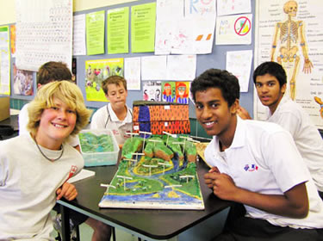
DIPLOMA PROGRAMME AT A GLANCE
WHAT IS THE INTERNATIONAL BACCALAUREATE DIPLOMA PROGRAMME?
a CHALLENGING TWO-YEAR CURRICULUM for motivated college-bound students in the junior and senior year of high school,
that leads to a SPECIAL DIPLOMA, in addition to your New York State diploma,
can open OPPORTUNITIES for: acceptance in highly selective colleges college credit and advanced placement (as much as a full year!) scholarships,
and combines RIGOROUS ACADEMICS with ACTIVITIES in sports, the arts, and community service.

Slide 9

Number of Diploma Program Schools
IB Africa, Europe
& the Middle East
870
IB Americas
1664
IB Asia Pacific
502
3,110 Diploma Program schools in 150 countries
Notes:
9

Slide 10
The IB DP in New York State
51 Schools have the IB Diploma Program
  -18 member schools in the WNY IB Consortium
  -3 IB World Schools in Erie County
    City Honors Buffalo
    Kenmore West
    Kenmore East

Slide 11
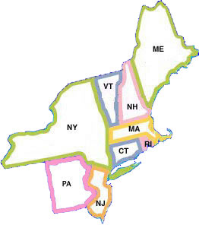
Dr. Cathy Battaglia
Teacher
Principal at City Honors
Community Superintendent City of Buffalo
Past President The Guild of IB Schools of the Northeast (GIBS)

Slide 12
David Coates
Kenmore East School Counselor
Past President of NYSACAC (New York State Association for College Admission Counseling)

Slide 13
University recognition: How well is the diploma recognized by universities?
The IB diploma is widely recognized by the world’s leading universities.
The IB works closely with universities in all regions of the world to
gain recognition for the IB diploma:
Direct online access for university admissions officers and government officials to syllabuses and recent examination papers
A database of university admission policies on www.ibo.org
Recognition in over 100 countries
Recognition by over 2,000 universities
Some universities offer scholarships and advanced placement for IB students
Students applying to a particular university can access their grades
directly from the IB’s secure web site.
Page 13

Slide 14
IB and College
Acceptance
  Widely recognized, even recruited from various universities
  Scholarships available
Preparation
  Let’s hear from a few college students
Credit
  Some schools offer up to 30 credits – UB, Binghamton, Sarah Lawrence
  Your mileage may differ
  Caveats:
    very few graduate in 3 years
    skipping courses may not be advisable

Slide 15
College Credit
Differs by school (see www.ibo.org)
  Up to 30 credits for diploma at UB, Canisius, other SUNY schools – credit may be awarded for individual courses
  Sophomore standing: UB, Ithaca, Harvard
  Credit for individual exams depending on score
  University of Rochester: $10K scholarship per year for IB Diploma

Slide 16
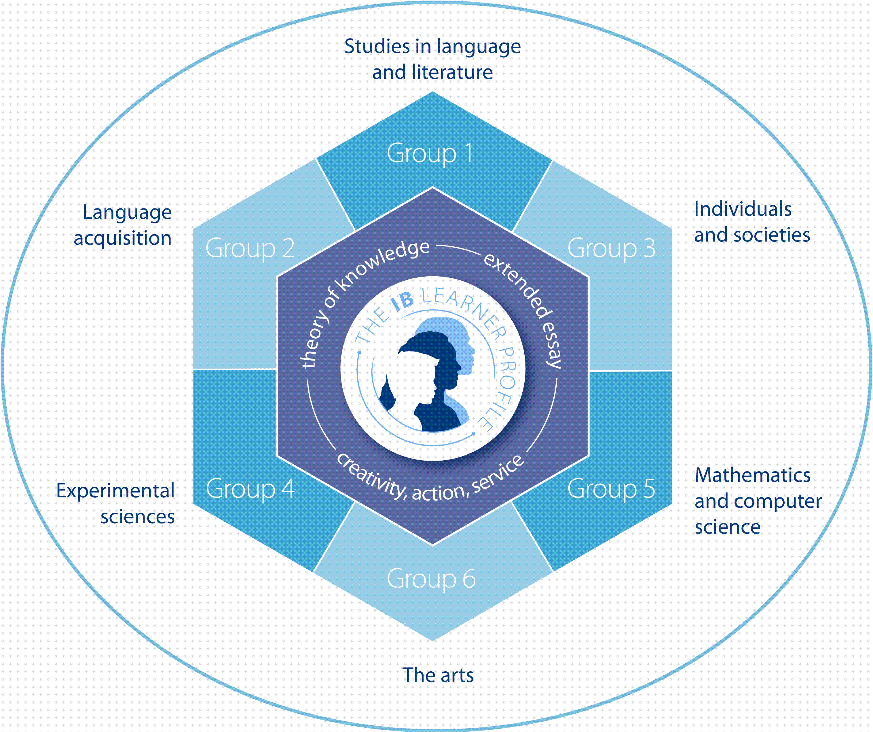
THE IB DIPLOMA PROGRAMME REQUIREMENTS
The curriculum contains
SIX
SUBJECT GROUPS,
and a
THREE PART CORE.
Notes:
16
The programme is presented as six academic areas with three core requirements enclosing the student at the center.
It encourages the concurrent study of a broad range of academic areas. Students study: two modern languages; a humanities or social science subject; an experimental science; mathematics; and one of the creative arts.
Three core elements – the extended essay, theory of knowledge and creativity, action, service – are compulsory and central to the philosophy of the program.

Slide 17

The Core: The Extended Essay
To get an IB diploma, all candidates must successfully complete an extended essay
4,000 words
Written over 2 years of program
Offers the opportunity to investigate a research question of individual interest
Students have faculty advisor who can offer limited assistance with the paper
Familiarizes students with the independent research and writing skills expected at university

Slide 18

The Core: Creativity, Action, Service
All diploma candidates must complete a Creativity, Action and Service (CAS):
Encourages students to be involved in artistic pursuits, sports and community service
Education outside the classroom
Development of the learner profile
Not an ‘hour count’ but a series of reflections showing goal setting, leadership and personal growth

Slide 19

The core: Theory of knowledge
All candidates must successfully complete the TOK course:
How do we know? (Epistemology)
Explores the nature of knowledge across disciplines
Interdisciplinary
Encouraging an appreciation of other cultural perspectives

Slide 20
Chris Knab
Social Studies teacher and department chair
Teaches Regents, AP, and IB
Theory of Knowledge

Slide 21
The IB Diploma Programme
Notes:
21

Slide 22
The KE IB Handbook
College and University Recognition (pg. 4)
  SUNY Fredonia a new addition – 30 credits for the IB Diploma
Kenmore East Academic Honesty Policy (pg. 23-27)
  Extremely important – Academic Malpractice
    Plagiarism: claiming the work of another as your own
    Collusion: supporting the malpractice of another
    Duplication of work: turning the same work in in more than one course
  Students subject to KE rules, until the IB declaration is signed, then it is an IB issue
IB Regulations available on our web site General Regulations for Students and Parents

Slide 23
Fees
Page 23
Registration fee $168
  Paid for by the district for all diploma candidates
Course fee $116
  An ‘exam’ fee for each class
  Similar to the AP exam fee
  Responsibility of the family
  6 @ $116 = $696
Course fees will be paid for students on free or reduced lunch
Savings Plan
  Fees due in September of senior year
  18 months @ ~$40/month would cover the fees

Slide 24
Kenmore East
Pathway to an IB Diploma

Slide 25
Fees and leaving the program
A student dropping one or more classes in their senior year would no longer be a diploma candidate, hence responsible for his/her registration fee
This student would not be paying for the course dropped
However many courses dropped the fee will not be more than $624

Slide 26
Principles of Diploma Program from The Diploma Program, From Principles to Practice, IBO, 2009.
Learning how to learn
  To become lifelong independent learners
Access
  Students do not have to be geniuses, they need to try, work and think
Creative Teach Professionalism
  Outstanding, ongoing professional development for teachers

Slide 27
Sophomore Course Selection
 | Advanced | Grade Level
English | AP English Language and Composition
LOTE | Continue with Language
Social Studies | AP Euro | Global 10 Regents or Honors
Science | Chemistry | Biology Regents or Honors
Math | Algebra II/Trig | Geometry
Visual Arts | Studio Art or Multimedia Studio Recommended: Drawing and Painting
Music | Music Theory /AP Music (suggested)

Slide 28
THE SUBJECT CURRICULUM
Students study one subject from each subject group.
Three subjects are studied at “higher level” 240 Hours over two years
Three subjects are studied at “standard level” 150 hours over two years

Slide 29
IB Course Selection

Slide 30
How are IB students scheduled?
Very carefully…

Slide 31
Sample IB Schedule
Period | Day 1 | Day 2 | Day 3 | Day 4 | Day 5 | Day 6
1 | BIOLOGY | LOTE | BIOLOGY | LOTE | BIOLOGY | LOTE
2 |  |  |  |  |  | STUDY HALL
3 | ENGLISH | HISTORY | ENGLISH | HISTORY | ENGLISH | HISTORY
4
5 | TOK | PE | TOK | PE | TOK | PE
6 | LUNCH | LUNCH | LUNCH | LUNCH | LUNCH | LUNCH
7 | ELECTIVE/ STUDY HALL | ELECTIVE/ STUDY HALL | ELECTIVE/ STUDY HALL | ELECTIVE/ STUDY HALL | ELECTIVE/ STUDY HALL | ELECTIVE/ STUDY HALL
8 | MATH | ART | MATH | ART | MATH | ART
9 |  | STUDY HALL |  |  | STUDY HALL

Slide 32
Sample IB Schedule w/Music
Period | Day 1 | Day 2 | Day 3 | Day 4 | Day 5 | Day 6
1 | ES&S | LOTE | ES&S | LOTE | ES&S | LOTE
2 |  |  | STUDY HALL |  |  | STUDY HALL
3 | ENGLISH | HISTORY | ENGLISH | HISTORY | ENGLISH | HISTORY
4
5 | TOK | PE | TOK | PE | TOK | PE
6 | LUNCH | LUNCH | LUNCH | LUNCH | LUNCH | LUNCH
7 | ENSEMBLE | ENSEMBLE | ENSEMBLE | ENSEMBLE | ENSEMBLE | ENSEMBLE
8 | MATH | MUSIC | MATH | MUSIC | MATH | MUSIC
9 |  |  |  |  | STUDY HALL

Slide 33
Sample IB Schedule w/ Music and AM PE
Period | Day 1 | Day 2 | Day 3 | Day 4 | Day 5 | Day 6
AM |  | PE |  | PE |  | PE
1 | ES&S | LOTE | ES&S | LOTE | ES&S | LOTE
2 |  |  | STUDY HALL |  |  | STUDY HALL
3 | ENGLISH | HISTORY | ENGLISH | HISTORY | ENGLISH | HISTORY
4
5 | TOK | STUDY HALL | TOK | STUDY HALL | TOK | STUDY HALL
6 | LUNCH | LUNCH | LUNCH | LUNCH | LUNCH | LUNCH
7 | ENSEMBLE | ENSEMBLE | ENSEMBLE | ENSEMBLE | ENSEMBLE | ENSEMBLE
8 | MATH | MUSIC | MATH | MUSIC | MATH | MUSIC
9 |  |  |  |  | STUDY HALL

Slide 34
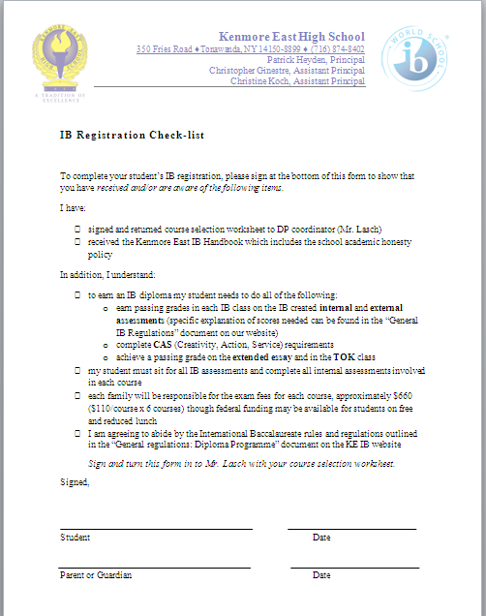
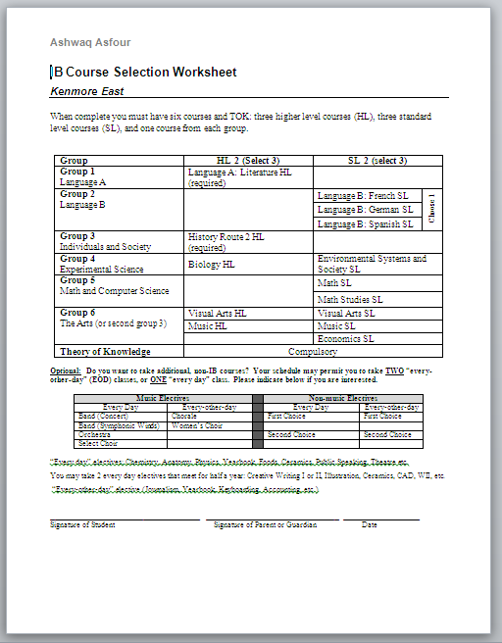
Registration Plan
Parent and student need to complete and sign
  IB Course Selection Worksheet
  IB Registration Checklist

Slide 35
IB Registration Checklist
sign and return course selection worksheet and the registration checklist to DP coordinator (Mr. Lasch)
receive the Kenmore East IB Handbook which includes the school academic honesty policy

Slide 36
IB Registration Checklist
In addition, I understand to earn an IB diploma my student needs to do all of the following:
earn passing grades in each IB class on the IB created internal and external assessments (specific explanation of scores needed can be found in the “General IB Regulations” document on our website)
complete CAS (Creativity, Action, Service) requirements
achieve a passing grade on the extended essay and in the TOK class
my student must sit for all IB assessments and complete all internal assessments involved in each course
each family will be responsible for the exam fees for each course, approximately $696 ($116/course x 6 courses) though federal funding may be available for students on free and reduced lunch
I am agreeing to abide by the International Baccalaureate rules and regulations outlined in the “General Regulations for Parents and Student” document on the KE IB website

Slide 37
Kenmore East High School
International Baccalaureate Diploma Programme Personnel
Robin Zymroz, Assistant Superintendent for Curriculum and Instruction
Patrick Heyden, Head of School
Paul Lasch, programme coordinator
Paul Lasch, English A1 HL
Jeff Diegelman, English A1 HL
Eileen Sauret, French B SL
Peggy Lucero , German B SL
Ivette Padin, Spanish B SL
Michael Ray, History HL
Karen Machniak, History HL
Alex Perry, Economics SL
Bob O’Connor, Biology HL
Dr. Dan Yox, Physics SL
Ralph Critelli, Environmental Systems and Societies SL
Jeff Orlowski, Math Studies SL
Dan Gustafson, Math SL
Richard Scaduto, Visual Arts SL/HL
Mike Ihde, Music SL/HL
Christopher Knab, ToK
Denise Carr, CAS coordinator
Jeff Liss, EE coordinator
John Vogt, guidance liaison
Amy Young, library liaison

Slide 38
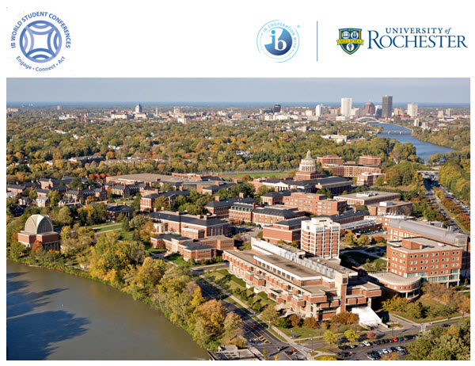
IB World Student Conference 2017
Rochester, NY
University of Rochester

